Slide 1
[
]
WEBCENTER OWNER OVERVIEW
A SYSTEM FOR YOUR SUCCESS

Slide 2
WEBSOLUTIONS PROVIDES A SYSTEM TO
Generate cash flow NOW!
Build a successful UNFRANCHISE

Slide 3
The Product & Service Is this a product/service that I like and is there a market for it?
Profitability What is the potential behind the opportunity?
The System How does the system work
Support What kind of support is available to help my business grow
It’s important to explore all of the areas and make an educated decision to go into business for yourself, but not by yourself.
How to Get Started What are my options to get going?
Notes:
TRAINER’S NOTES:
This is an intro of what to expect
Quick slide – do not go into detail

Slide 4
Where do you
Get your news
Socialize
Research
Find products
Find services
Play
Get Music
Get Books
Get Periodicals
Get Advice
Everyone is “Plugged in”.
We are all consumers of the internet in some way, shape or form!
Notes:
TRAINER’S NOTES:
Here are some talking points:
We are all consumers of websites in our every day lives. Think about where you read your news, socialize etc.
Would you agree that people are plugged in and get much of their information online?
Businesses need to be online so they can interact with their customers and potential customers
Customers have an expectation to be able to browse websites for products, information and services

Slide 5
A PROVEN, DUPLICATABLE, SYSTEM TO PROVIDE
SMALL BUSINESS OWNERS AN EFFECTIVE INTERNET PRESENCE
TOGETHER, WE HELP BUSINESSES AND ORGANIZATIONS WITH:
Increasing Revenues
STREAMLINING BUSINESS PRACTICES
Decreasing Expenses
INCREASING ENGAGEMENT
Increasing Customer Satisfaction
MARKETING THEIR BUSINESS
Notes:
TRAINER’S NOTES:
Again, it’s about using phrases which help set the stage for the larger context of your partnership, so it’s all about “we” not “I”.

Slide 6
We are a partnership Market America WORLDWIDE, MaWebCenters
& you
Notes:
TRAINER’S NOTES:
Remember, it’s a strategic partnership. We are all in business for ourselves, but not by ourselves. You partner with two powerful companies as part of your business model, Market America Worldwide which provides logistical and business development support and maWebCenters who provides the technology support and customer service
Many companies these days rely on strategic partnerships to become stronger and have better longevity and success, you are doing the same thing but within
Together we are helping small- medium sized businesses grow their business while simultaneously growing our own.

Slide 7
WE OFFER SOLUTIONS THAT ARE:
PROFESSIONAL
AFFORDABLE
EASY TO MAINTAIN
ALL-INCLUSIVE
SECURE
SUPPORTED
A PARTNERSHIP
Notes:
TRAINER’S NOTES:
Our solution offers professional, affordable solutions to being effective online
We know it’s overwhelming, and are proud to offer simplicity back into your life so you can focus on more important things, like running your business

Slide 8
What Makes Us Different
We provide an entire online marketing strategy based on the customers’ needs and on-going support.
Let’s take a look at the options, tools, and resources that our clients have.
Notes:
TRAINER’S NOTES:
Introduce the concept of online marketing strategy verses just a website

Slide 9
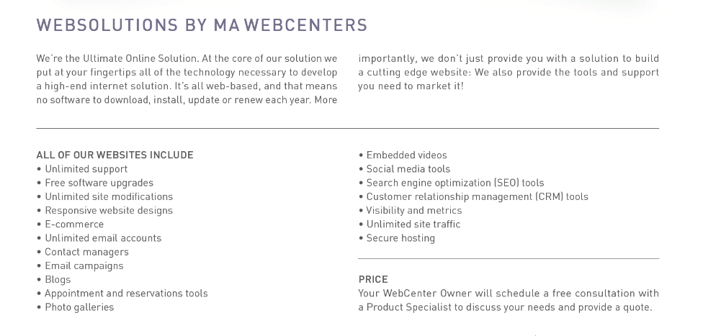
MORE THAN JUST A WEBSITE
Notes:
Trainers Notes:
This is just an intro slide – The goal here is to get them excited about what we are going to talk about.
In brief, cover the big topics “Websites, Marketing Tools, Unlimited, Support, Security)
The goal is to paint a simple picture of how all –inclusive our solution actually is / Instill confidence in the product.
Spend 1 minute or less on this slide – the details are coming up!

Slide 10
WEBSITE DESIGN
Your website design not only reflects your business but also determines how engaged your visitors are
OPTION 1: TECH SUPPORT Website Clients have unlimited access to Tech Support
OPTION 2: DESIGN CENTER
Purchase Design. Our designers can design a professional website with strong branding within the WebSolutions platform.
www.mawebcenters.com
Notes:
TRAINER’S NOTES:
Clients have two choices for designing their site
Choice one is to do it themselves. Tech support will help them with technical questions, but the business owner is the one doing the work
The other option is to purchase a design package where our team does it for you
DC Adds Value!
Better Experience for your Client!

Slide 11
DESIGN CENTER

Slide 12
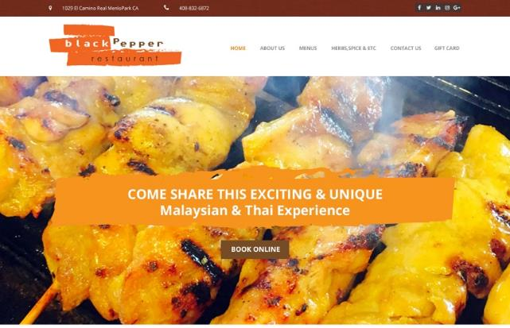
DESIGN CENTER

Slide 13
DESIGN CENTER

Slide 14
AWARD WINNING UNLIMITED CUSTOMER CARE
Unlimited help editing the site
Support using all features & tools in our solution
Home country, 24/7 support
Ultra-secure hosting facility 24x7 Security and incident monitoring, hosted on tiered, high performance Dell PowerEdge servers, protected from fire, floods, earthquakes, power outages, and other types of disasters
Dual-layer firewall protection Using Cisco PIX firewalls
Notes:
Trainers Notes:
Share Stories!

Slide 15
The Power of Unlimited
Unlimited Pages
Unlimited Changes
Unlimited Traffic
Unlimited E-mail Address
Unlimited Web Content Storage
Unlimited support, changes and upgrades.
We take away the challenges that business owners face to stay current with their online marketing solution.
Notes:
Trainers Notes:
Self Explanatory

Slide 16
DIGITAL MARKETING:
Marketing your business through digital channels.
OPTION 1: TECH SUPPORT Website Clients have unlimited access to Tech Support
OPTION 2: SERVICES
Purchase Digital Marketing Products.(Can be purchased by existing clients or non-website clients)

Slide 17
SOCIAL MEDIA
Social Media Management, Online Reputation Management, Facebook Advertising
SOCIAL MEDIA
DIGITAL MARKETING
Local SEO, Regional SEO, Google Advertising, Content Writing, Wordpress.org
WEBSITE HOSTING & MANAGEMENT
Basic Monthly Membership Monthly Maintenance & Management Managed Monthly Membership
TEXT MARKETING & COMMUNICATIONS
Landline & Toll-Free Text Marketing Portal
Automated or Real-time Texting Service
WWW.MAWC411.COM
Notes:
TRAINER’S NOTES:
Showcases all of the services that a client can purchase through maWebCenters
The big difference is whether someone will do it themselves, or leverage our teams of experts to do it for them

Slide 18
Let’s take a look at earning potential
Retail Profit
BV
Growth Potential
Notes:
TRAINER’S NOTES:
Earning potential will be demonstrated in terms of short term and long term growth potential

Slide 19
AVERAGE RETAIL PROFITS :
USA, MX, CAN, AU: $1,000
UK: £700
HK: HK$7,700
TW: NT$32,000
ES: €800
Divide your short term goal by your average
retail profit to determine how many sales it will take to reach your goal.
For example: A USA WCO has $5,000.00 in debt divided by $1,000.00 = 5.
Therefore, just 5 new sales could pay for the initial goal of $5,000 USD.
Short term goals can be met with retail profits
Notes:
TRAINER’S NOTES:
Again – you can apply this to any of your fixed cost goals

Slide 20
Each website sold
generates 230 BV
Each active client
generates
5, 30 or 35 BV / Mo.
DIGITAL MARKETING PRODUCTS GENERATE ADDITIONAL BV AND RETAIL PROFITS
Notes:
TRAINER’S NOTES:
Long Term Potential for WCOS = Ongoing BV and Retail Profits

Slide 21
Build share of customer
Your client buys a website
ITEM | RETAIL PROFIT | BV
WEBSITE SALE | $1,000 | 200 BV 30/ MO.
DESIGN PACKAGE | N/A | N/A
SOCIAL MEDIA MANAGEMENT | $15/ MO. | 20 BV/ MO.
PREMIUM FACEBOOK ADVERTISING | $10/ MO. | 15 BV/ MO.
BASIC GOOGLE ADVERTISING | $24/ MO. | 24 BV/ MO.
TOTAL INITIAL SALE | $1,000 | 289 BV
TOTAL RECURRING | $49/ MO. | 89 BV/ MO.
AND wants to market the site
YOU CAN START WITH A WEBSITE SALE OR A DIGITAL MARKETING PRODUCT SALE
GROW THE RELATIONSHIP TO BUILD SHARE OF CUSTOMER
Notes:
TRAINER’S NOTES:
Take a look at what the Digital Marketing Products generate
Remember, full pricing and BV is available on mawc411.com/support.html

Slide 22
THE WEBCENTER PROGRAM PROVIDES SEVERAL WAYS FOR YOU TO CREATE LEVERAGE AND EXPAND YOUR BUSINESS
SHOPPING ANNUITY & BUSINESS SERVICES
GLOBAL BUSINESS & EMP
UNFRANCHISE BUSINESS
Notes:
TRAINER’S NOTES:
This is where we talk about growth potential. It’s not just about what the UFO can achieve on their own – let’s show them the opportunities they have to build further!
Prospecting / Recruiting
Building share of customer
Global expansion

Slide 23
SMALL BUSINESS OWNERS = MORE OPPORTUNITIES
SHOPPING ANNUITY
BUSINESS SERVICES
UNFRANCHISE BUSINESS
CONDUCT A BUSINESS SPENDING ASSESSMENT
CONVERT SPENDING & OVERHEAD INTO INCOME
SHARE THE B2B CATALOG
BUILD SHARE OF CUSTOMER WITH OTHER RELEVANT PRODUCTS AND BUSINESS SERVICES
SHARE THE BUSINESS OPPORTUNITY
SMALL BUSINESS OWNERS ARE ENTREPRENEURS

Slide 24
Australia
Bahamas
Bermuda
Canada
Chile
China
Columbia
Costa Rica
Dominican Republic
Ecuador
Hong Kong
Indonesia
Ireland
Jamaica
Macau SAR China
New Zealand
Panama
Philippines
Singapore
Spain
Taiwan
United Kingdom
United States
YOUR GLOBAL WEBCENTER
Your WebCenter is automatically enabled to sell websites globally in all Market Countries & EMP Countries. You earn Home Country Retail Profit & BV!
Notes:
TRAINER’S NOTES:
What does that do for us?
First, by having websites which are completely in other languages and the entire back end of the system, including the menus and contextual help, the business owners who are more comfortable with another language will be able to take more effective use of the solution.
Second, by providing all the support, from sales to ongoing support with clients, all in multi-languages.
As a non-native speaker, you can probably find numerous business owners who you can have a short conversation to set an appointment with, but you wouldn’t be able to do a sales walkthrough because the business owner might not understand English well enough. This way, all you need to do is set the appointment, and let the team handle the rest for you!
And we all know that some of your best business prospects are business owners and customers of yours. This is a very natural way to lead to prospects for the business in a cultural market you might not have thought you could make inroads to.

Slide 25
BUSINESS OWNERS BUILD STRONG NETWORKS THAT WORK TOGETHER TO RUN A SUCCESSFUL COMPANY.
RATHER THAN TRADING TIME FOR MONEY, THEY FOCUS ON CREATING A SUCCESSFUL ORGANIZATION.
BUSINESS BUILDING
CREATING LEVERAGE

Slide 26
WEBCENTER PROGRAM
Who is this program for? ANYONE
WebCenter Owners have access to sell the line of WebCenter products, WebCenter Program Benefits and Teams of Professionals.
SOCIAL MEDIA
WEBCENTER PRO PROGRAM Fully customizable website, Co-branded storefronts, invoicing and admin, Ability to create and store layouts in the library, VIP Technical Support, Pro Education Series
Pro Affiliate: Industry Pros with light access to the UnFranchise Business, income potential of $1,500/wk
Pro Partner: Industry Pros or WCOs who have sold over 20 websites w/ FULL access to the UnFranchise Business with unlimited income potential with up to $3,600 per Business Development Center.
Notes:
TRAINER’S NOTES:
Understand the different programs which exist for folks who would be interested in leveraging our system

Slide 27
tHE INTERNSHIP PROGRAM provides a way for WEBCENTER CANDIDATES to be coached by an experienced WebCenter Owner.
EARN RETAIL PROFITS TO LAUNCH YOUR WEBCENTER BUSINESS
Learn more www.mawc411.com/grow_eng.html
Notes:
Trainers Notes
Duplication is critical and there are a number of ways for you to duplicate the power of the WebCenter Program in your organization, one of which is via Internship.

Slide 28
We’ve established
We have an incredible product that is a profitable investment for your client!
There is solid earning and growth potential for you, the WebCenter Owner
Now let’s learn about the system behind the product and potential!
Notes:
Trainers Notes:
Again – another Impact Slide! Just a reminder – “We have an awesome product and there is a market place for what we are selling”.
Now we transition into the next point of evaluation – “the system”

Slide 29
OUR SYSTEM IS BUILT ON SELLING APPOINTMENTS
THEN LEVERAGING OUR TEAMS OF PROFESSIONALS TO DO ALL OF THE HEAVY LIFTING
Notes:
TRAINER’S NOTES:
You are not the sales, design or technical expert
There are professional teams that work for you who will do this heavy lifting for you

Slide 30
AS A REMINDER
Teams of Professionals include:
Product Specialists
DESIGN & DIGITAL TEAMS
Customer Care
Notes:
TRAINER’S NOTES:
You are not the sales, design or technical expert
There are professional teams that work for you who will do this heavy lifting for you

Slide 31
Proven system for success
YOU TALK WITH BUSINESS OWNERS AND SET AN APPT.
SALES TEAM
DESIGN, DIGITAL, SUPPORT TEAMS
CLIENT GETS A GREAT SITE AND SUPPORT MARKETING IT
Notes:
TRAINER’S NOTES:
1 minute
Shows the simple sales system.

Slide 32
Your WebCenter provides you with all of the tools you need to leverage our proven system for success
Customer relationship management, search engine tools, social media tools, mobile websites and more!
Sales Support, Design Center, SPECIAL TEAMS, Customer Care, and STANDARDIZED WEBCENTER TRAINING
A front-end website to market your website sales business
Access to domains , emails AND email marketing
An interactive sales calendar to schedule appointments
Notes:
TRAINER’S NOTES:
30 seconds
Quick slide to acknowledge the marketplace and opportunity to do business in this industry is BOOMING.

Slide 33
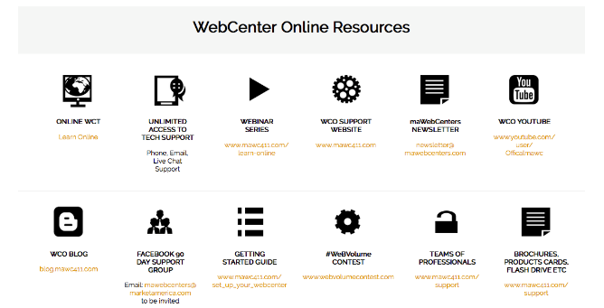

Slide 34
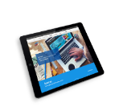
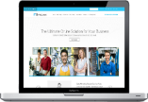
YOUR OPTIONS
Proven system for success
WEBCENTER INTERN
LEARN THE PROCESS
LEVERAGE THE PROFESSIONALS
EARN RETAIL PROFIT TO LAUNCH YOUR WEBCENTER
WEBCENTER FAST START
LAUNCH YOUR UNFRANCHISE
SELECT THE WEBCENTER FAST START KIT
PURCHASE WEBCENTER CODE #6040 $350.00USD 300BV
REACTIVATE WEBCENTER CODE #6040RA $150.00USD NO BV
Notes:
TRAINER’S NOTES:
Briefly cover the options to get started as a WebCenter Owner

Slide 35
The Product & Service All-inclusive, superior online marketing solution to help businesses market their business
Profitability Substantial retail profit & BV potential with opportunities to domestically & globally
The System A simple sales system, supported by teams of professionals
Support Standardized trainings, webinars, meetOn, printed materials, teams of professionals
How to Get Started Fast Start Kit, Become a WebCenter Owner, Internship
Let’s go ahead and re-ask those important questions!
Notes:
TRAINER’S NOTES:
Revisits the initial questions we wanted to answer for the person evaluating this as a business opportunity
Impact slide – hit the points hard but quickly

Slide 36
YOUR NEXT STEPS
GET YOUR QUESTIONS ANSWERED Register for webinars and review www.mawc411.com
BOOK A FOLLOW-UP Schedule an appointment to get your questions answered and learn about the UnFranchise
ESTABLISH YOUR WEBCENTER Purchase your WebCenter or Register your UnFranchise with the WebCenter Fast Start Kit
Notes:
TRAINER’S NOTES:
Self explanatory

